Slide 1
1
2
3
4
RNN
recurrent
computation
is
slow
1
1
1
1
Transformer
recurrent
computation
is
slow
Recurrent
Transformer
1
1
2
2
recurrent
computation
is
slow

Slide 2
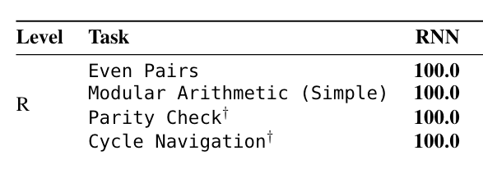
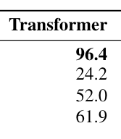
Staircase

Slide 3
Standard Attention
X_{0,1}
X_{1,1}
X_{2,1}
X_{0,0}
X_{1,0}
X_{2,0}
Staircase Attention
K_{2,1}
K_{1,1}
K_{2,1}
K_{0,2}
K_{1,1}
K_{0,1}
K_{0,0}
K_{1,0}
K_{2,0}

Slide 4
Group 2
Group 1

Slide 5


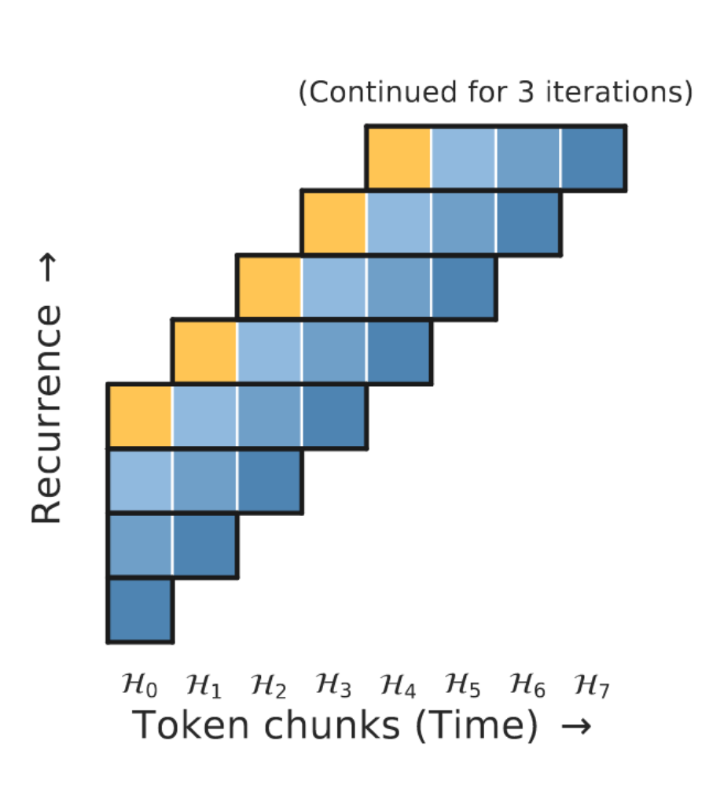


Slide 6

